Slide 1
demand
Law of Demand

Slide 2
T-shirt Company
1) You and a partner will design a t-shirt that you think will sell amongst your peers
You will have about 7 minutes to design your product
2) Once you have your design, collect your data
Go around the class and present your t-shirt. Ask what price they would be willing to pay for your shirt.
Tally mark how many people that corresponds with the dollar amount (on worksheet)

Slide 3
Part II
You and your partner should graph your data
X – Axis: Quantity Demanded
Y – Axis: Price
Create a line of best fit through your data points

Slide 4
Demand
The quantity of a good or service that buyers are willing and able to buy at all possible prices during a period of time
The Law of Demand:
As the price of a good or service rises (or falls), the quantity that people are willing and able to buy during a certain period of time falls (or rises)

Slide 5
Law of Demand
Ceteris paribus
All things being equal
IF THEN,
Price : Quantity demanded

Slide 6
Law of Demand
Ceteris paribus
All things being equal
IF THEN,
Price : Quantity demanded
Inverse Relationship

Slide 7
Role of Consumer

Slide 8
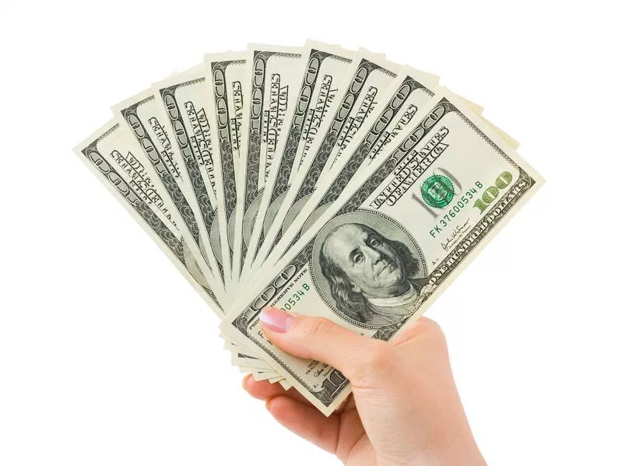
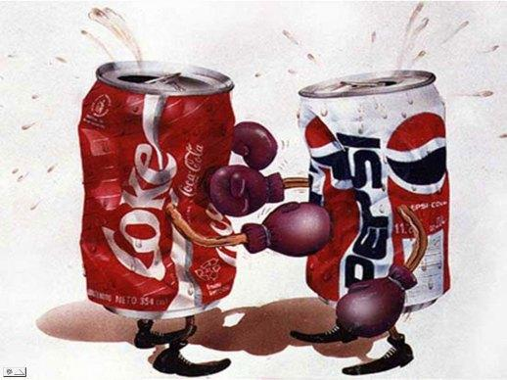
Factors of demand
Shifts of demand curve
T: taste
I: income
M: market size
E: Expectations
R: Related goods

Slide 9
Taste
Change in preference
What happens if you enjoy coffee more than you did before?
A positive change
in preference, increases
the quantity demanded
for that product
Shift to the right

Slide 10
Taste
Change in preference
What happens when you become sick of coffee?
Decrease in preference
for a product, decreases
the quantity demanded
for that product
Shift to the left

Slide 11
Income
Personal income affects consumer spending and demand
What happens to your coffee spending habits when you receive a raise?
An increase in income, increases the demand for a product

Slide 12
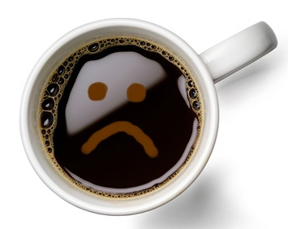
Income
Income is an inverse relationship
What would happen to your coffee habit if you lost your job
=
A decrease in income, decreases the demand for that product

Slide 13
Normal Vs Inferior Goods
Normal good
Goods or services purchased in relation to income
If income increases, demand also increases
Inferior goods
A good that is less expensive than another good
Does not necessarily demonstrate quality changes
As income increases, the demand decreases

Slide 14
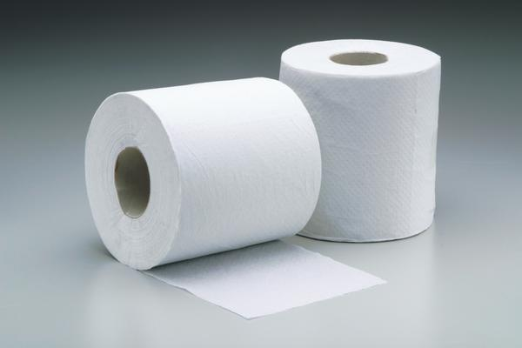
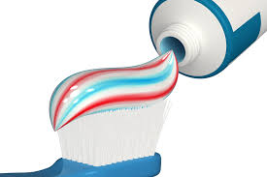
Neutral Goods
What about toilet paper?
Neutral good:
Products that despite income changes, do not increase or decrease in demand
The goods that you need to buy anyway regardless of your income
You do not buy more toilet paper just because you got a raise (unless you had 0 in the first place)

Slide 15
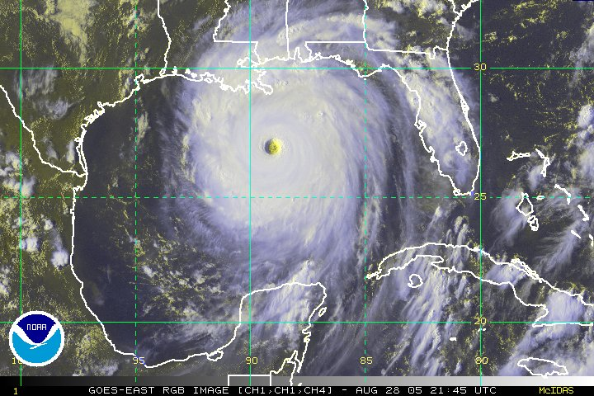
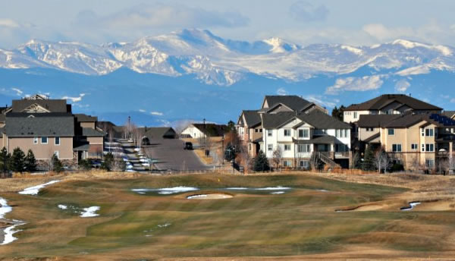
Market Size
Shift in demand based on demand size
If market size increases, demand increases
If market size decreases, demand decreases
Hurricane Katrina
Colorado expansion

Slide 16
Expectations
Expectations as a demand shifter to depend on time
What if you knew that your favorite jacket was on sale next week?
What does your demand look like now?
If the expectation tells a consumer to wait, the demand will decrease (now)
If the expectation tells a consumer to grab the product now, the demand will increase (now)

Slide 17
Related goods
Related goods are considered either substitute or complementary goods
Substitute good: any good or service that can replace the original good or service
Ex: coffee and Red Bull
Complementary good: goods or services that are related or correlated with the original good or service
Ex: pools and pool cleaning services

Slide 18
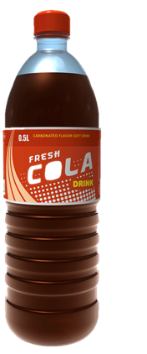
Related Goods
Price of substitute goods or services
If the price of tea/soda/energy drinks decreases, the demand for coffee decreases
P = Q

Slide 19
Related Goods
Price of substitute goods or services
If the price of tea/soda/energy drinks increases, the demand for coffee increases
P = Q

Slide 20
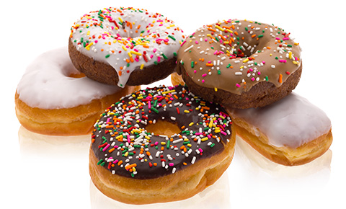
Related goods
Price of complimentary goods
If the price of donuts go up, demand for coffee goes down
P = Q

Slide 21
Related goods
Price of complimentary goods:
If the price of donuts go down, demand for coffee goes up
P = Q

Slide 22
Graph it!
Brad Pitt starts wearing only Ray-Bans. Graph the demand for Ray-Bans.
Swimming pool cleaning service prices go up by 200%. Graph the demand of swimming pool services.
Pizza prices drop here at school, what happens to the salad bar? Graph it!

Slide 23
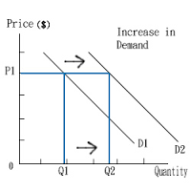
Changes in Demand
Change in Quantity Demanded
VS
Change in Demand

Slide 24
Change in Demand
Movement along a demand curve is a change in quantity demanded
If price goes down, the quantity demanded will go up
Price only changes quantity demanded
Shifts in a demand curve is a change in demand
Price stays the same, people just bought more…but why?
TIMER
5 shifters only change demand

Slide 25
Graph it!
Label everything
1) Weather forecasters say that a coming holiday weekend will be sunny. Stores see increased sales for sunglasses, sunblock, and beach chairs.
2) The government issues tax rebate checks to taxpayers, hoping they will increase spending, stimulating the economy. Sales of cars, electronics, and clothing go up.
3) When a coffee shop cuts the price of bagels, people want to buy more bagels

Slide 26
4) Online prices for contacts increase.
5) The price for bananas has decreased, now King Soopers has too many strawberries
6) The price of iPhones have gone up, Samsung Galaxies are seeing huge sale increases.
7) the Detroit Red Wings are eliminated from the playoffs. Attendance for the weekend’s Detroit Tiger game go up.
8) Due to a frost in Georgia, the prices of peaches goes up.
9) You got a raise and are making more than minimum wage now! What happens to your eating out habits?
10) The Colorado Front Range has seen over 100,000 people move in since 2014. What happens to the demand of goods in Colorado?

Slide 27
Come up with your own
Come up with a product you might be interested in researching – be specific
Graph 3 decreases in demand and 3 increases in demand using TIMER
Describe what is happening for each shift – you are coming up with the market scenario
Bonus: add a graph and scenario for your product that demonstrates a slide on the demand curve

