Slide 1
Gross Domestic Product

Slide 2
GDP gauges
How do we use GDP to tell us whether our economy is in a recession or how rapidly our economy is expanding?
How do we take the effects of inflation out of GDP to compare economic well-being over time?
And how do we compare economic well-being across countries?

Slide 3
GDP gauges
What indicators tell us a country is “healthy”?
What indicators tell us an individual is happy (economically)?
Can GDP tell us both?

Slide 4
Why we use GDP
Used to measure the relative value of goods and services produced in an economy, especially during different years
Has a monetary value

Slide 5
GDP?
Gross Domestic Product
Total output (or market value) of goods and services
The total market value of all final goods and services produced in a given year
Citizen-supplied or foreign supplied resources employed within the country
U.S. GDP includes market value of Fords produced in American-owned Michigan factory and the market value of Hondas produced by a Japanese-owned factory in Ohio

Slide 6
GDP
GDP’s definition includes 4 important parts:
Market value
Final goods and services
Produced within a country
In a given time period

Slide 7
1) Market Value
GDP is an indicator of market value – the value of goods and services at market prices
Is value – price?
To add apples and oranges, computers and popcorn, we add the market values to a calculate a total value of output in dollars

Slide 8
2) Final goods and services
GDP is a value of final goods and services
A final good (or services) is an item bought by its final user during a specific time period.
Final good vs intermediate good
Item produced by one firm, bought by another, and used as a final component of a final good or service
Excluding intermediate goods and services avoids double counting in GDP calculations.

Slide 9
Produced within a country
Produced within a country – domestic production
Citizen-supplied or foreign supplied resources employed within the country
U.S. GDP includes market value of Fords produced in American-owned Michigan factory and the market value of Hondas produced by a Japanese-owned factory in Ohio
GDP measures production during a specific time period
Usually a quarter or a year
In a given time period

Slide 10
What GDP does not include
1. Second hand sales [no current production]
2. Public/private transfer payments [no current production]
3. Purely financial transactions [no current production]
4. Intermediate goods [components of final good]
5. U.S. Corporations producing overseas
6. Non-market transactions [household or volunteer work]
Underground Economy [“bads”]
7. Illegal business activity [prostitution, murder-for- hire, illegal drugs, ect.]
8. Unreported business activity [“off the books”]
Does this count?

Slide 11
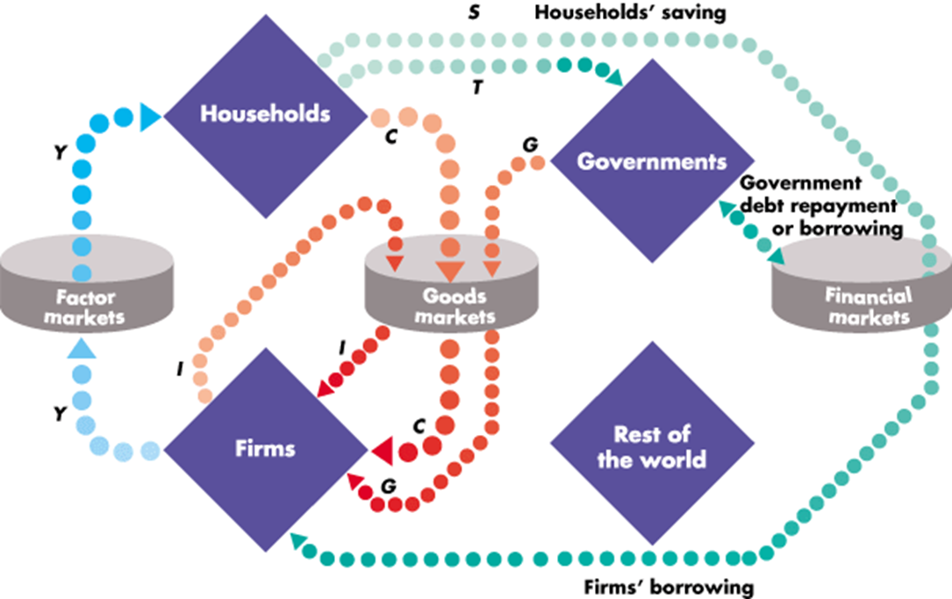
GDP Calculations

Slide 12
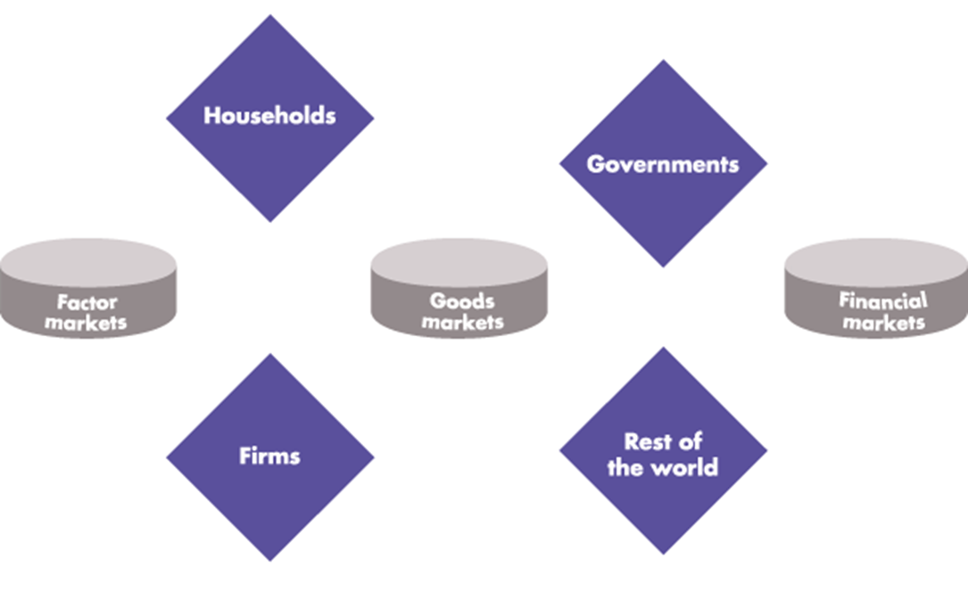
The circular flow diagram shows the transactions among households, firms, governments, and the rest of the world.

Slide 13
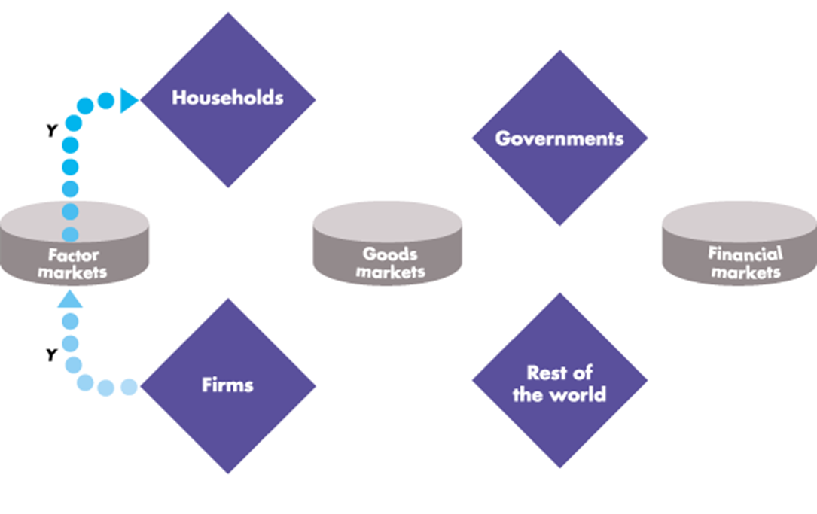
Firms hire factors of production from households. The blue flow, Y, shows total income paid by firms to households.

Slide 14
Households buy consumer goods and services. The red flow, C, shows consumption expenditures.

Slide 15
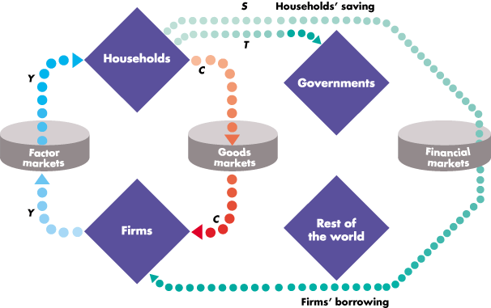
Households save, S, and pay taxes, T. Firms borrow some of what households save to finance their investment.

Slide 16
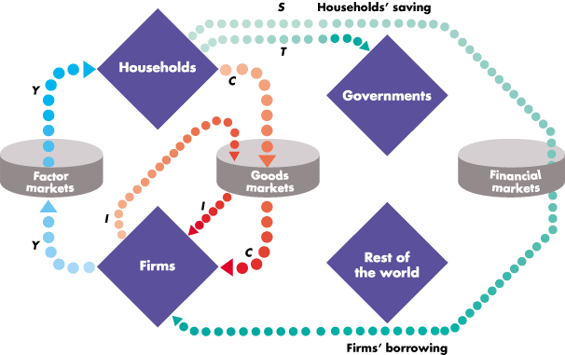
Firms buy capital goods from other firms. The red flow I represents this investment expenditure by firms.

Slide 17
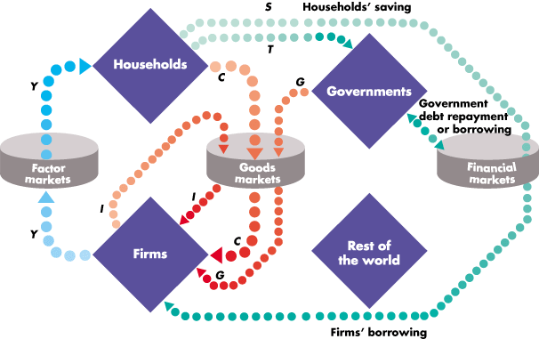
Governments buy goods and services, G, and borrow or repay debt if spending exceeds or is less than taxes.

Slide 18
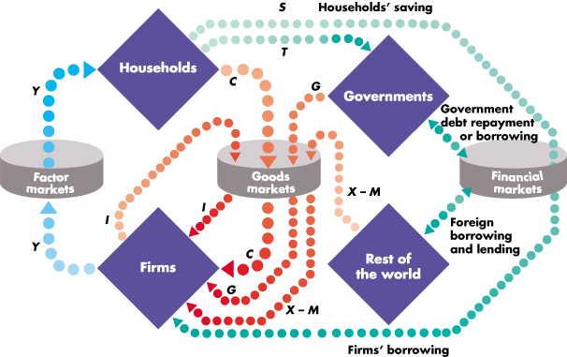
The rest of the world buys goods and services from us, X, and sells us goods and services, M—net exports are X - M

Slide 19
The blue and red flows are the circular flow of expenditure and income. The green flows are borrowing and lending.

Slide 20
GDP (Y) = C + G + I + (X-M)

Slide 21
C, I, G, X, & M??
C= Consumer spending
I = Investment (Gross fixed Capital Formation)
G= Government Spending
X= Exports
M= Imports

Slide 22
Real GDP
The value of final goods and services produced in a given year when valued at constant prices
Calculating Real GDP
The first step in calculating real GDP is to calculate the nominal GDP
Nominal GDP is the value of goods and services produced during a given year valued at the prices that prevailed in that same year

Slide 23
GDP vs GDP per capita
GDP = GDP per capita
Population
Good way to compare countries, as it shows relative performance

Slide 24
GDP Basics
https://www.youtube.com/watch?v=SYFYla1H7KE
Economics and Fiscal policy

Slide 25
So how does GDP help goals?
1) Economic Equity
2) Economic Freedom
3) Economic Growth
4) Economic Sustainability
5) Economic __________
6) Economic ________

Slide 26
GDP measures Growth
As GDP measures growth of nation, they have to sacrifice on sustainability
Sustainability
When a nation’s population lives a or above a preferred level of comfort
So if a country wants their entire population to remain at a comfortable level, they will not experience growth
United States as a market economy almost always values growth more than sustainability

Slide 27
Standard of living
Intangible concept that seeks to represent a country’s level of economic prosperity.
The more growth = higher standard of living
If GDP measures growth, does it measure Standard of Living as well?
C-SPAN

Slide 28
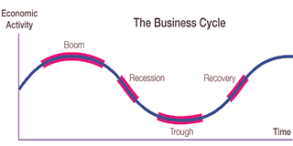
The Business Cycle

Slide 29
Recessions Vs depressions
Recessions
2+ quarters of slowed growth
Depressions
long term, downturn in growth
Governments will make decisions within these periods to alleviate economic tensions
Banished Activity

