Slide 1
Market Structures
4 types of markets

Slide 2
Monopolies
A market that has a single firm
Considered the extreme of a capitalist market
Firms dominate the market
Pricing controls
Create prices that are in the self interest of the firm, not the consumer
3 Major Characteristics:
Firm control over the market:
Total or close to total control over the market
Consumer control:
Little to no consumer influence on the market
Type of product:
Unique, highly specialized

Slide 3
Monopolies
Mergers and consolidations are highly regulated
To avoid creating super-sized monopolies
Monopolies are often considered illegal
Sherman Anti-Trust Act
1890 by Senator John Sherman
Ensure an even playing field for all firms
Intended to keep the market competitive
Partner Talk
Who is a monopolistic firm looking out for?
Thinking way back……does a monopoly have more or less negative externalities? WHY?

Slide 4
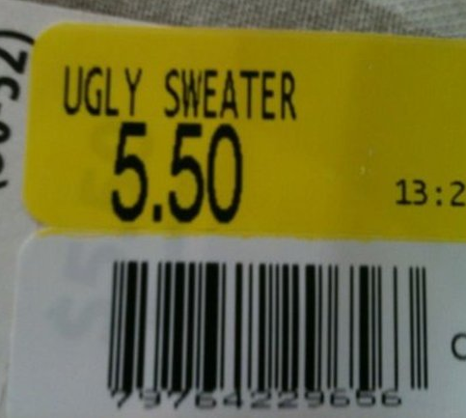
Perfect Competition
Market competition that follows 5 patterns/guidelines
1) all firms sell an identical or similar product
2) all firms do not control the market price for a product
Who controls the market then??
3) all firms has a small market share
4) buyers have market information about the product and know the price charged by each firm
5) the market has lots of freedom of entry and exit
Not too difficult to enter into the market as a firm
Entrepreneurship does best here

Slide 5
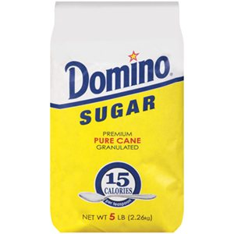
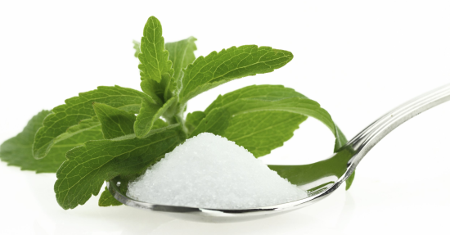
Perfect Competition
Exact opposite of a monopoly
The market has many buyers and sellers
Lots of substitutes for goods and services that are considered expensive
Partner talk
Because of the amount of substitutes and competition, do individual companies make the moogah bucks?? (high profits?)
Even though firms have identical/similar products, why do they try to differentiate their products?

Slide 6
Monopolistic Competition
Considered imperfect competition
When many firms produce and sell differentiated goods or services
These goods are varied and different but not substitute goods
There might be multiple companies that make these goods, however they might different enough
Firms will set prices on the market, like perfect monopolies
Mostly free market entry and exit
EX: restaurants, hairstylists

Slide 7
Price Discrimination
When firms undercut other firms through prices
Price changes for similar or identical products for different people
EX: student discounts, senior discount, bulk pricing
Relies on consumer willingness to pay new prices and the elasticity of their demand
To maintain competition with products that are similar
Common and almost necessary

Slide 8
Oligopolies
“a state of limited competition, in which a market is shared by a small number of producers or sellers”

Slide 9
Oligopolies
Only a few large firms control the market
Higher barriers of entry for new firms (though not impossible)
Independent decision making
Tend to set prices
eventually increasing their profits, as they are set higher than the market price
OR alternatively, one company can severely drop prices to take business from the other firms

Slide 10
Non-collusive Oligopolies
A small number of firms that control the market, but do not communicate with one another
These companies don’t have a need to communicate to control that market
Ex: Cable industry or U.S. car companies
“The Big Three”

Slide 11
Collusive Oligopolies
Small number of firms who do create pacts or “contracts” with one another
Communication helps reduce uncertainty in the market
All taking a slice of the risk
Firms will set prices
By acting as one company
Firms have total control over supply
EX: OPEC
Organization of Petroleum Exporting Countries
EX: Cartels

Slide 12
Reflection
Answer with at least 2-3 sentences each
1) In your own words; why do cartels fail?
2) Are oligopolies and monopolies necessary in market economies?
3) What are/I the biggest issues with monopolies in economies?
4) Which creates more “inside” competition? Collusive or non-collusive oligopolies? WHY?
5) What are the benefits of a monopoly? An oligopoly (non- collusive or collusive)?

