Slide 1
Roman Republic

Slide 2
Roman Kingdom: 753-509 BC
Roman Republic: 509 -27 BC
Roman Empire: 27 BC – 395 AD

Slide 3
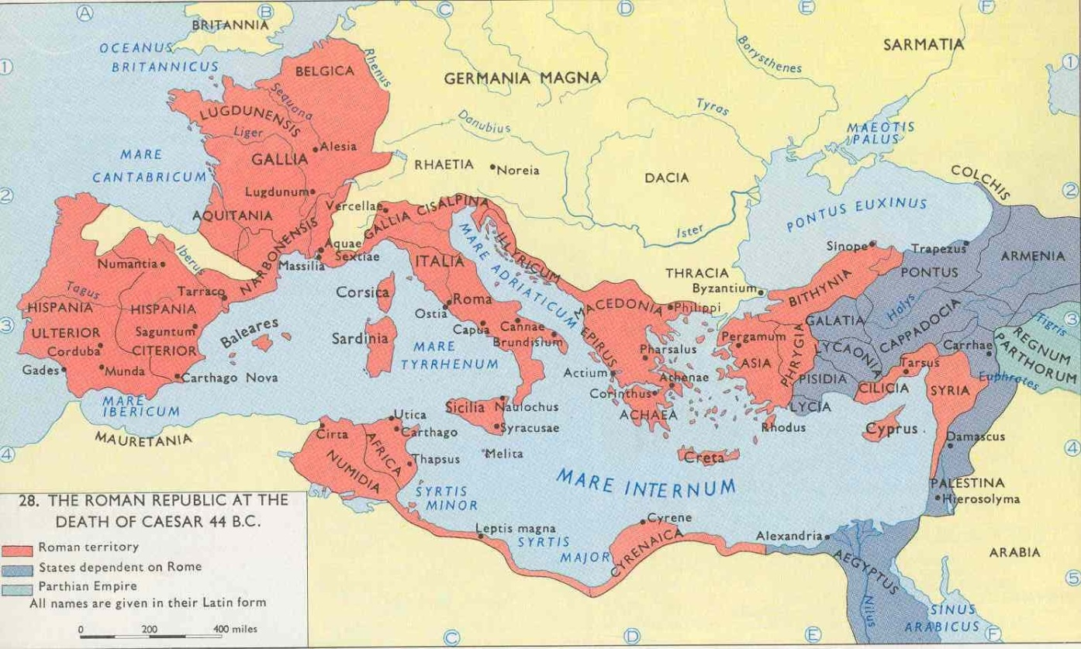
Roman Republic
509 – 27 BC
Roman control expanded into surrounding cities and into the entire Mediterranean area
Increased empire through conquest and alliances

Slide 4
Roman Republic Government
Head by two consuls
Consul: highest level government position
Two consuls are elected each year by citizens, serve one year term
Advised by a senate of appointed officials
Lead military decisions and civil decisions
Limits on power
Two consuls could veto each other
Meant to prevent abuse of Rex Sacrorum (kingship)
Had judicial and executive power
Specific rights will be allocated from consuls to other individuals
Censors (census taking), chief judges (judicial power)

Slide 5
Roman Republic Government
Consul limitations
In additional to veto power, consuls could bring an appeal a veto
One consul could complete office duties once a month
Then switch the roles with the other consul
After their term:
Their actions during their term will be evaluated and criticized
3 basic restrictions
1) short office term of one year
2) consul decisions was pre-decided by a Senate
3) Consuls could not immediately take office after their term
Could revisit office after 10 years

Slide 6
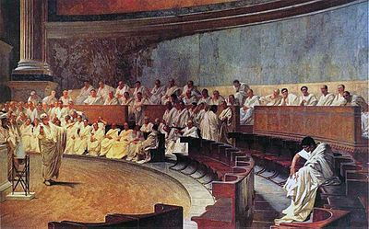
Roman Republic Government
Senate
Non-elected, Appointed magistrates (by consuls)
Advised the 2 consuls
Meant to uphold the Constitution of the Roman Republic
Controlled the money, administration, and foreign policy
During strife or emergency
Appoint a dictator to run the empire
Not often enacted
Passed “Ultimate Decree of the Senate” (something like martial law)
Only met in religious buildings
Senators could not own ships meant for trade or international banking

Slide 7
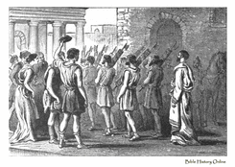
Roman Republic Government
Assembly
1. Committee
Made of all citizens of Rome
Enacted laws and tried cases
2. Council
Groups of individual people had councils
“Plebeian Council” – elected Plebeians, to pass laws that applied to Plebeians

Slide 8
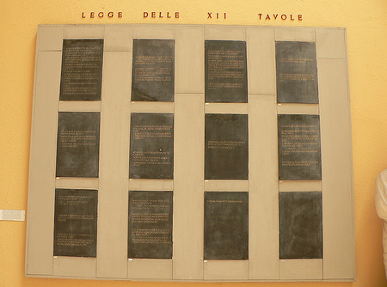
Roman Republic Government
12 Tables
First attempt for widespread enforced law throughout the Republic
Binding for both patricians and plebeians
Plebeians will be unhappy with the decisions
Laws about private rights
Lacked laws about family rights, & processes for trade transactions

Slide 9
Social Classes

Slide 10
Social Classes
Patricians
Ruling class families
Origins: 100 men appointed senators by Romulus
“fathers” and their decedents
Plebeians
Roman commoner
Free, citizens, working class
Extremely rare, but they could gain enough money to join the patrician class
Little power, but high population
Why did patricians want to prevent plebeians from holding important positions?

Slide 11
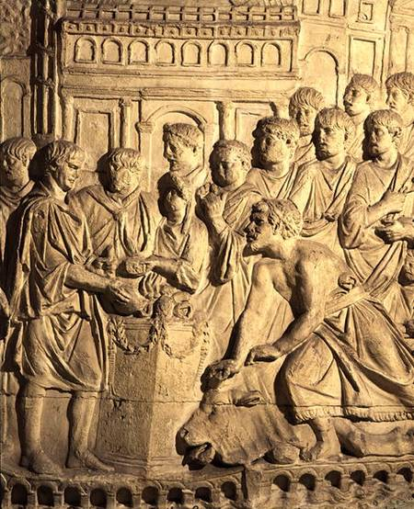
Social Classes
Tributes
Tax or payment to a nation
Enacted on conquered lands
Tax on all imported produce (sometimes on exports from Rome)
Payment of allied nations to the Roman Republic
These allies will pay for their alliance but never be considered citizens
Overall, pay for soldiers and ability to increase the empire
Eventually these individuals will gain citizenship against the warnings of the Senate

Slide 12
Land-owning
Latifundium (Latifundia)
Divisions of land for crop bearing or livestock
Large Roman farming estates
Initially begun as spoils of war
Conquered people were turning their land to Roman officials
One of the ways Senators could make money
No naval trading, turned to farming instead
Start to purchase surrounding land
Only slaves will be working these estates
Farmers (individual land owning) will be part of the Roman armies
Onset of “agribusiness”
Concept of villas – large land estates

Slide 13
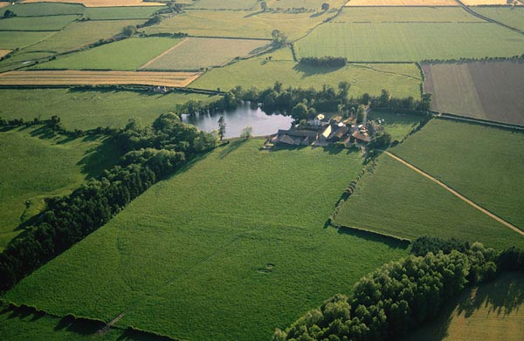
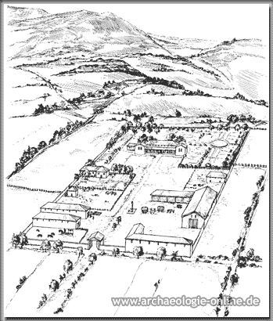
Latifundia

Slide 14
Military campaigns
Legions and the Punic Wars

Slide 15
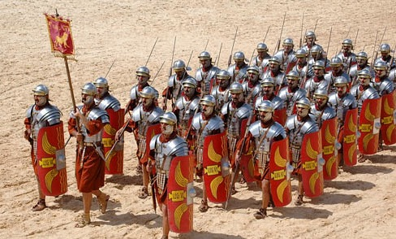
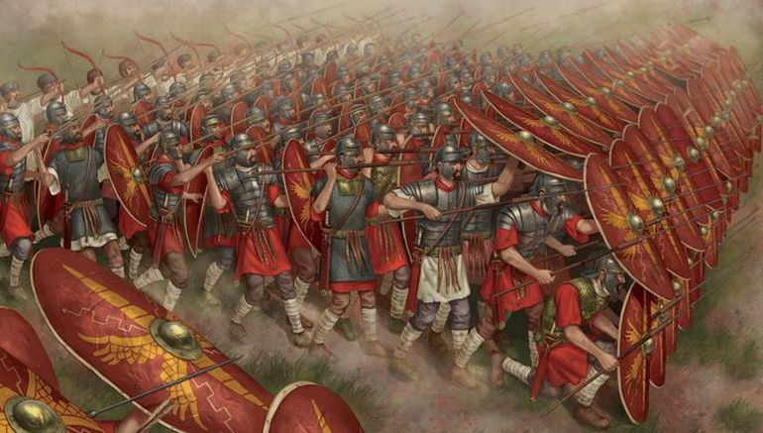
Roman Military
Legion:
Largest Roman army
3,000-5,200 men (varied at times of war)
Became more formally organized in the Roman Republic
Controlled by a consul
Formed by 3 units
Equites: prestigious cavalry unit
Velites: light infantry – poor citizens who could not afford proper army
Javelin-throwers, harass the enemy, or cover up movement
Heavy infantry: citizens that could afford equipment

Slide 16
Punic Wars
Carthage
“Great Jewel of the Mediterranean”
Controlled most of north Africa
Older than Roman Empire
Human (baby) sacrifice rituals are said to be the beginnings of the Punic Wars
Naval army is superior to Rome
Rome
Rome will take Carthage’s ship blue prints and create a navy
Still superior in hand to hand combat
23 years later – 1st Punic War
Roman victory over Carthage
Gain control over Sicily and Sardinia
Carthage will sign a treaty
Handing over the treasury to the Roman Empire

Slide 17
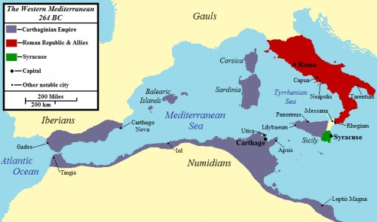
1st Punic War
264 BC - 241 BC
Naval heavy warfare
Roman victory over Carthage
Not a huge loss for either side, however decades of war will force peace terms
The crushing treaty influenced Hannibal’s perception of Rome

Slide 18
2nd Punic War
218-201 BC
Carthage attempted invasion of Rome
Lead by Commander Hannibal
Takes over much of Spain at first
Leads his army from Africa through the Alps Mountains to Rome
Cornelius Scipio
Roman general that will attack Hannibal and troops in Italy
Battle at Cannae
Hannibal will use the terrain to his advantage
Surrounds Roman troops, used strategic maneuvers and trap the Romans
50,000 Romans KIA vs 5,700 Carthaginians

Slide 19
2nd Punic War

Slide 20
2nd Punic War

Slide 21
2nd Punic War

Slide 22
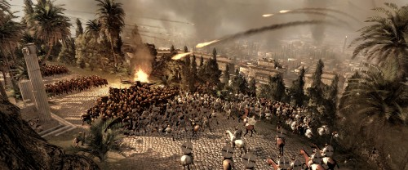
3rd Punic War
149 – 146 BC
“Carthage must be destroyed”
Utica – Carthage’s long-time ally will surrender to the Romans
Rome will declare war and demand surrender
Told Carthaginians to leave Carthage and resettle elsewhere
Give up all arms
Carthage fights with perception of nothing to lose
Carthage will burn to the ground
Surviving soldiers will surrender
Cornelius Scipio will be awarded as a hero in Rome
Ultimately, Rome will spur a rapid increase of the empire for years to come

Slide 23
Roman Republic Reform

Slide 24
Gracchus Brothers
Tiberius (the elder) and Gaius
Born of the noblest class of plebeians
Father was a consul and mother was the daughter of Scipio Africanus
Tiberius
became a distinguished officer, served in the 3nd Punic War
Gained connections to the ruling elite
Will be elected an augur (below consul)
Created the commission that will oversee the redistribution of land
Gaius
Revived land reforms
Started fixed prices on grain for the urban population

Slide 25
Gracchus Brothers
Reforms were meant to address economic issues of the Republic
Reclaim land from wealthy landholders back to soldiers, displaced peasants
Through subsidizing grains for the needy, and the Republic paying for clothing
Failures
Overestimated the reliability of the people
Idealists
Increased conflicts between individuals and their own interests
Poor for more aid
Land-owning Senators to keep their land
Government became more violent against its people
Continued by following leaders of Rome

Slide 26
The beginning of the end

Slide 27
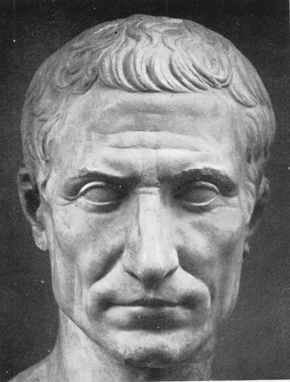
Julius Caesar
100 – 44 BC
Dictator (Emperor): 49-44 BC
https://www.youtube.com/watch?v=0556FLLkBT0

Slide 28
Julius Caesar
Roman Civil War
Pompey the Great and Caesar battle numerous times
Pompey will often be defeated
Beheaded in Egypt – the head sent back to Caesar
Warning signs for Caesar
Creates political and social change
Has complete power and declares himself dictator
Proclaims himself “Dictator for Life”
Essentially replaces the Republic
Keeps Senate - starting to plot
Changes tax laws and new land laws

Slide 29
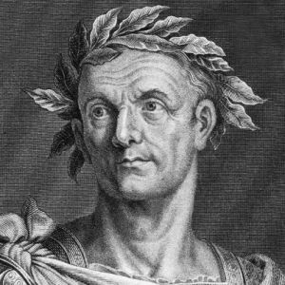
Julius Caesar
Brutus will lead a plot against Caesar
Ides of March – 44 BC
40 conspirators
23 daggers
“You too, my child?”
His death will lead to further breakdown of the empire, not a renewal as the Senate believed
Why did Caesar’s rivals feel they had to kill him?

Slide 30
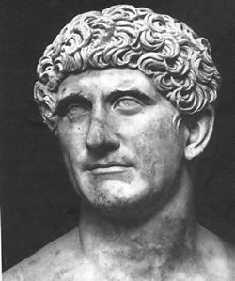
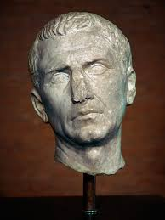
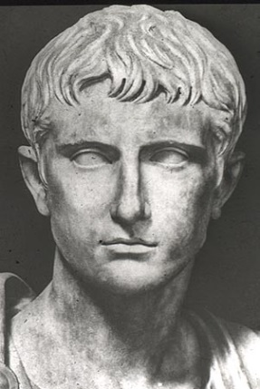
2nd Triumvirate
Following Caesar’s death, allies determined revenge on his killers
An attempt to stabilize the Roman Republic in its turmoil
Between:
Marcus Antonius (Mark Antony)
Marcus Aemilius Lepidus
Gaius Julius Caesar Octavian – Caesar’s grand-nephew
Distrust and differences plagued this alliance
Anthony blocked Octavian’s access to Caesar’s inheritance
Lepidus will be named Chief Priest which is supposed to go to Octavian
Unified in a will to avenge Caesar
Mark Antony
Marcus Lepidus
Octavian

Slide 31
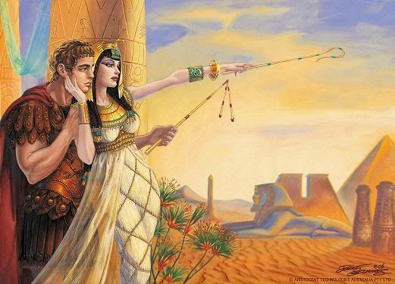
Roman Republic Civil War
Potentially inevitable
43 BC
Octavian is in control of the army at 18 years old
Demands from Senate to have the political authority that he needs
Soldiers enter the Senate
Octavian made as consul
First order – law that condemned all who killed Caesar
Fall of the Triumvirate
Octavian will declare war on Cleopatra
Antony’s love affair with Cleopatra,
while married to Octavia clouded
decision-making

Slide 32
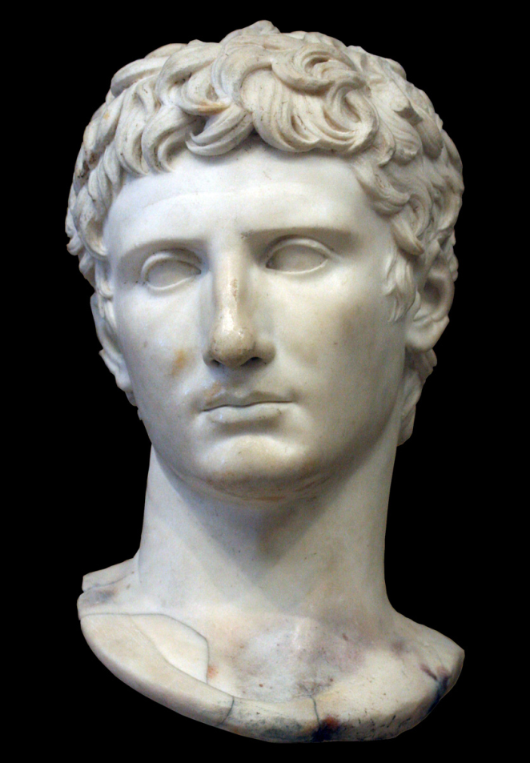
Roman Republic Civil War
Battle of Actium
31 BC
Antony and Cleopatra try to overrun Octavian
Loss for Antony and Cleopatra
Both will commit suicide
Octavian deemed a hero the Roman Senate
Rewarded with Augustus the first Emperor of the Roman Empire
onset of Emperors in the Empire
The Republic is completely dissolved

Slide 33
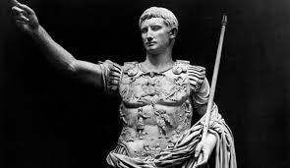
Emperor Augustus
Attempt at peace – lasted for 200 years
Travelled the Empire often
Paid his army well (money and land)
Each man swore an oath of allegiance
Able to maintain border peace
Protected (via bodyguards) against Ides of March
Took control of the treasury
Ordered complete census
“framework of assessment” for taxation
Close supervision and tracking maintained against civil conflict
Built new roads
Supervised the grain and water supply and roads

Slide 34
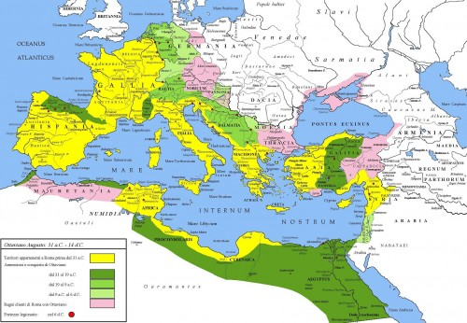
Emperor Augustus
Pax Romana
Period of relative peace for the Empire
Guarantee law, order, and security
Through seclusion, or even expanding the empire

Slide 35
Lasting peace?

Slide 36
Christian Prosecution
Fear over secret rituals
Misunderstood rituals - “wicked”, “evil deeds”, “blood and bloody”
Harbored fear for the Roman government
Increased legal problems
Illegal behaviors
Persecuted for rituals, even if not real
Religious texts are destroyed
Edict of Milan
Legalized Christian religion

Slide 37
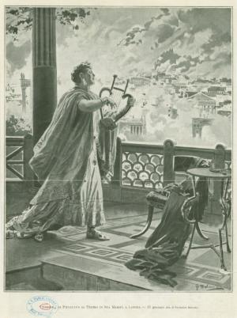
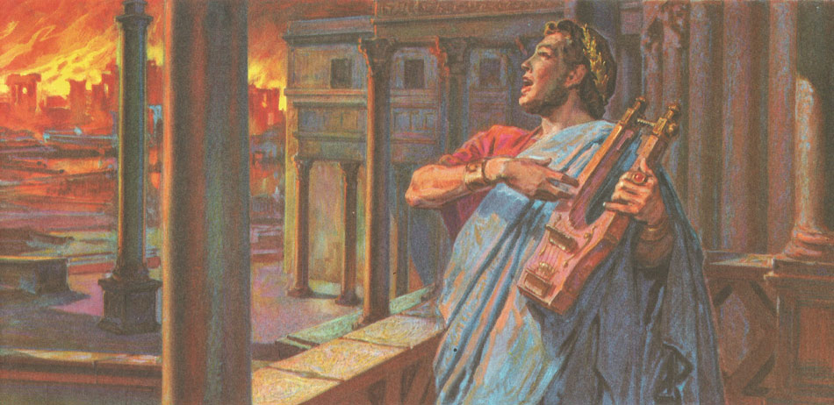
Christian Prosecution
Nero and the Great Fire of Rome
64 AD
Order the burning of Rome to kill or flush out the Christian population
Blame the Christians for arson
Intended as a fresh start for Nero
Build the city as he wanted it

