Slide 1
Standard of living
And the gdp

Slide 2
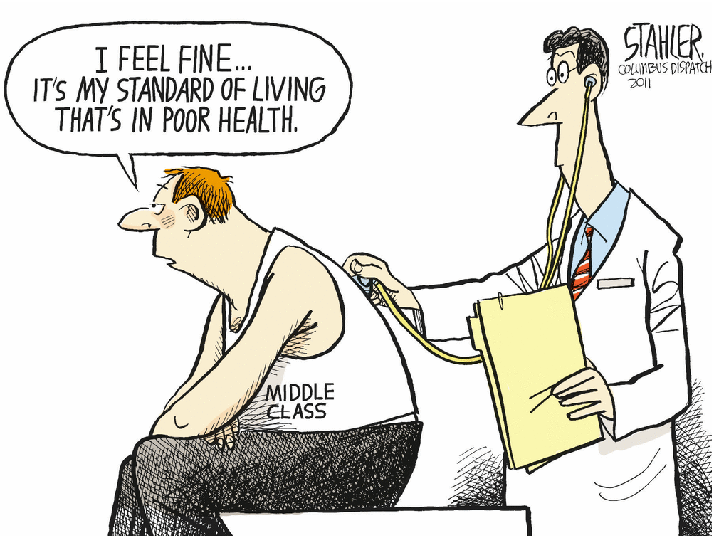
Standard of living
Intangible concept that seeks to represent a country’s level of economic prosperity
The more growth = higher standard of living
If GDP measures growth, does it measure standard of living as well??
Pros
Cons

Slide 3
The business cycle
Standards of living can change with the business cycle
Periods of economic growth and contraction lead to changes in lifestyles

Slide 4
The business cycle

Slide 5
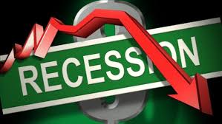
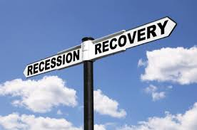
The business cycle
Boom
Highest economic point, right before a drop or recession
Recession
Slowed growth
Normal but difficult part
Trough
End of a period of decline
Recovery
Picked up growth
Increasing business activity
Unseen until months later

Slide 6
Recessions vs Depressions
Recessions
2+ quarters of slowed growth
Typically last 6 – 18 months
Often difficult to see until months later
Depressions
long term, downturn in growth
Multiple months of recessions
Blend of GDP decline and increased unemployment
Governments will make decisions within these periods to alleviate economic tensions
Banished Activity
https://wetheeconomy.com/films/recession/

Slide 7
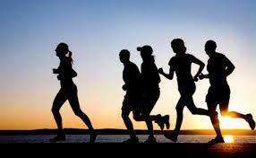
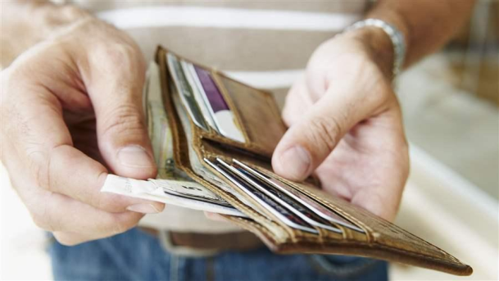
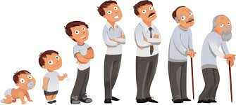
Standard of living
How do recessions affect standards of living?
Does the decline of a nation’s GDP indication lower standards of living?
What are indicators that you could look at to determine a certain standard of living?
Income (net vs gross)
Life expectancy
Health
Literacy rates

Slide 8
Standard of living
Take some time to research the basics of the standard of living
Work through the worksheet and determine the factors for standards of living around the world
Keep an eye out for how GDP influences standards of living
You may work with a partner (each of you will have your own sheet)
You may listen to music while working
SIGN OUT a Chromebook

