Slide 1
The Crusades

Slide 2
Crusade:
“lead or take part in an energetic and organized campaign concerning a social, political, or religious issue.”

Slide 3
First Crusade (1095-1099CE)
Europe:
Christians were fighting against Muslim troops (small fights) in the Eastern region
Over time, knights began aiding the Christians
Necessity for knights were declining
Started fighting amongst themselves
Pope started using these knights in the name of Christianity and its spread
Western Europe had been stabilized from numerous barbarian attacks (thanks Feudalism)

Slide 4
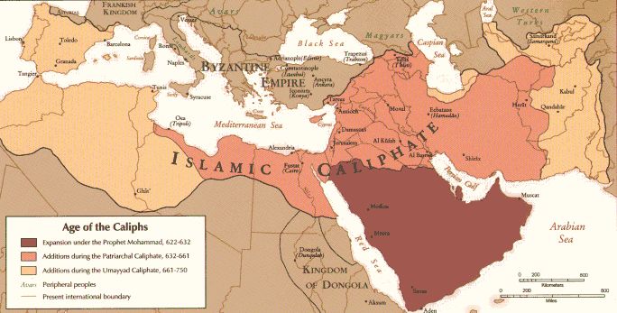
First Crusade (1095-1099CE)
Middle East
Continuously fought against the Byzantine Empire
Ruled mostly be Caliphates
Seljuqs: Sunni Muslims
Fatimid Caliphate: Shi’ite Muslims
Warfare amongst ruling groups
Dispute over Jerusalem (Seljuq ruled)

Slide 5
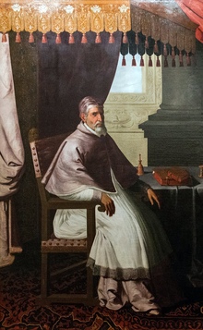
First Crusade (1095-1099CE)
Seljuk Turk tribes continued to attack the
Byzantine Empire
Pope Urban II
The Pope from 1088 – 1099 CE
Law-abiding and personable
Toured France and Italy often
Addressed the request of the Byzantines for help against invading Seljuq Turks
Gave a public speech and sermon for those to follow:
“Perhaps a massive pilgrimage may solve these problems”
“God wills it”
The true onset to the Crusades

Slide 6
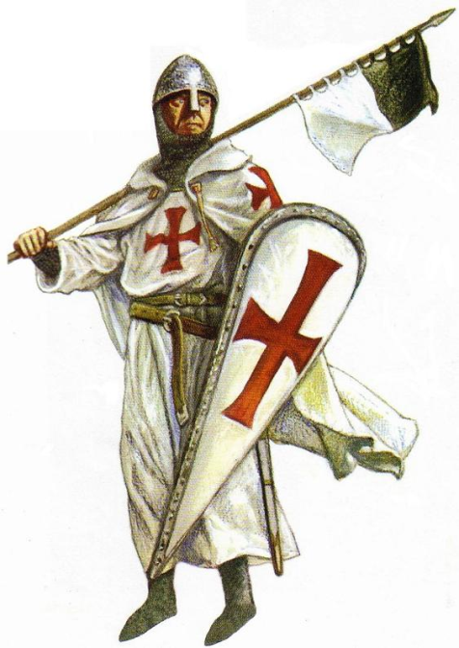
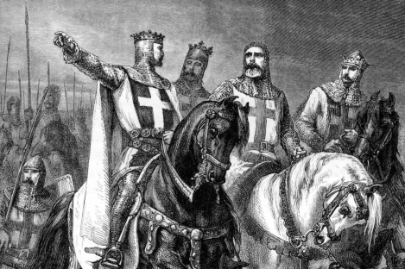
First Crusade Recruitment
Pope Urban turned to France first for support
Speeches to French nobles describing crime committed against Christians
Bishops began spreading the word
Italy, Germany, France
Attempted to stop sick, women, and monks from joining
Failed terribly
Instead of gathering knights, peasants were taking up arms
Unprepared, Ill-trained, and just ill
Peasant Crusader’s were less about greed and more trying to escape famine and harsh life realities
Knights did join (often French aristocrats)
Argument over their purpose
Trying to find a place/future outside of home

Slide 7
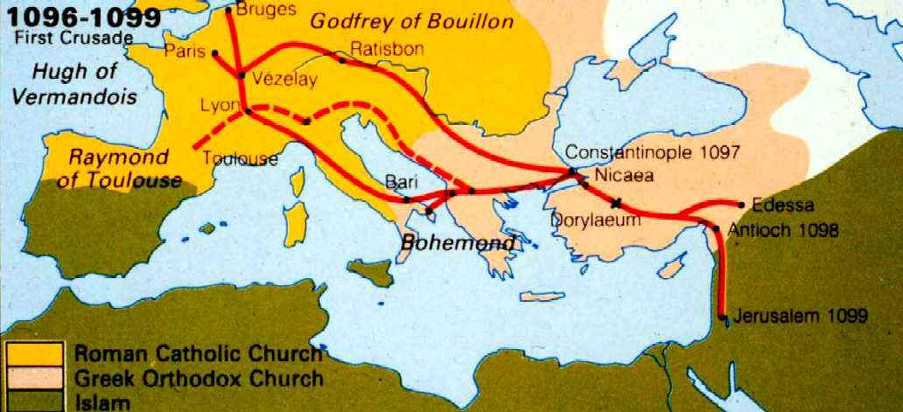
Goals?
Help out Byzantine Empire with invasions
Attempt to free Christians from Muslim rule
Reconquer Jerusalem
Had been under Seljuq rule

Slide 8
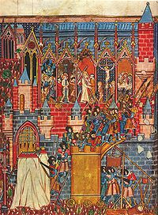
Results!
Considered a Crusader’s victory
Captured Jerusalem
Starving and dehydrated population
Massacred many Muslim and Jewish residents
Particularly in Jerusalem
Established “Crusader states”
Easing pressure on Byzantine Empire

Slide 9
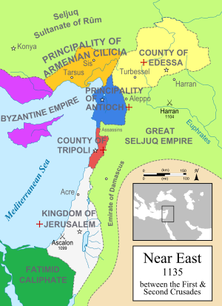
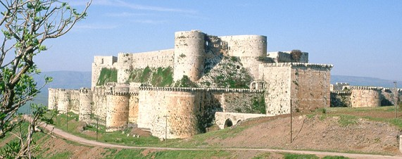
Second Crusade (1147 – 1149 CE)
Crusader states will have strongholds throughout conquered regions
Jerusalem, Edessa, Antioch and Tripoli
Have gained more Crusaders over the time
Muslims (the Seljuqs) had new found drive for their holy war (against the Franks)
Attack and overthrow Count of Edessa
Pope Eugene III called for “Quantum praedecessores”
Call for a second crusade
Bolstered by Crusade glory of the past

Slide 10
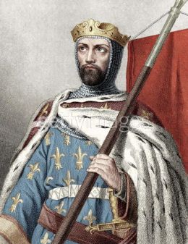
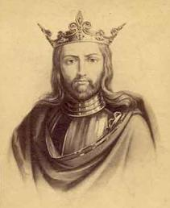
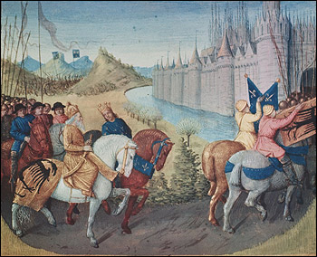
Second Crusade (1147 – 1149 CE)
German and French Crusaders were most influenced
King Louis VII of France and King Conrad III of Germany
Engaged in two separate paths/attacks
Attack on Damascus
King Louis and Conrad gathered their troops in Jerusalem
Crusaders consistently pushed back from the walls
Forced into land they were unfamiliar with
Guerrilla attacks and dehydration
Crusaders abandon the city
Returned to Jerusalem
Defeated emotions run through the Crusaders

Slide 11
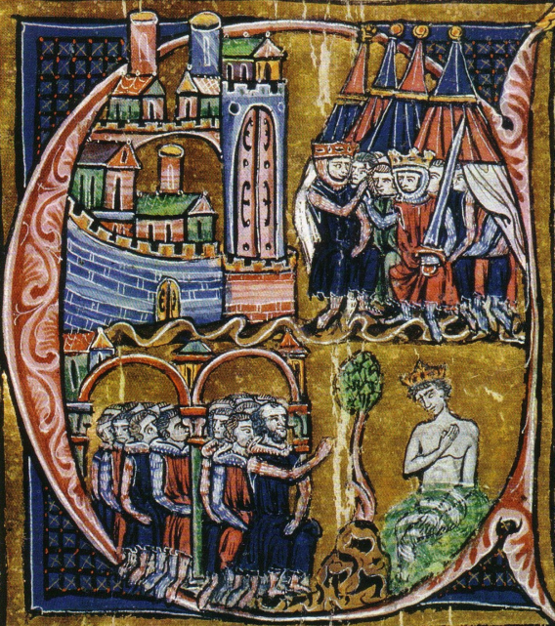
Results
Distrust between leaders (kings) and troops
King Louis going on his own to Jerusalem
Lack of aid from Western Crusaders
Humiliating defeat and apology to the Pope
“The work of the devil”
Distaste for crusading
Crusade literature, poetry, and artwork
Eastern Europe and France will have distrust for one another

Slide 12
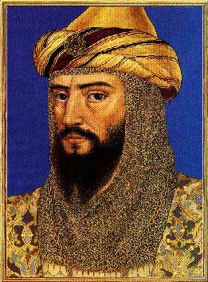
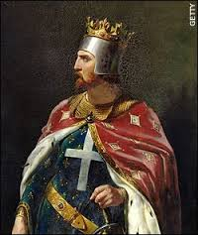
Third Crusade (1189-1192)
Also known as “The King’s Crusade”
Attempt to recapture The Holy Land from Saladin (mostly Jerusalem)
Saladin (Salah ad-Din)
Unified Middle Eastern states to fight against Christian troops
Richard the Lionheart
Sparked the 3rd Crusade
Did not allow Jews or women at his coronation
Jews were flogged and killed
People of London started attacks on Jews
Realizing a mistake (for his kingship), he condemns and attacks rioters
An attempt to re-polish the name, a call for crusades is made
Disgruntled by the fall of Jerusalem to Saladin

Slide 13
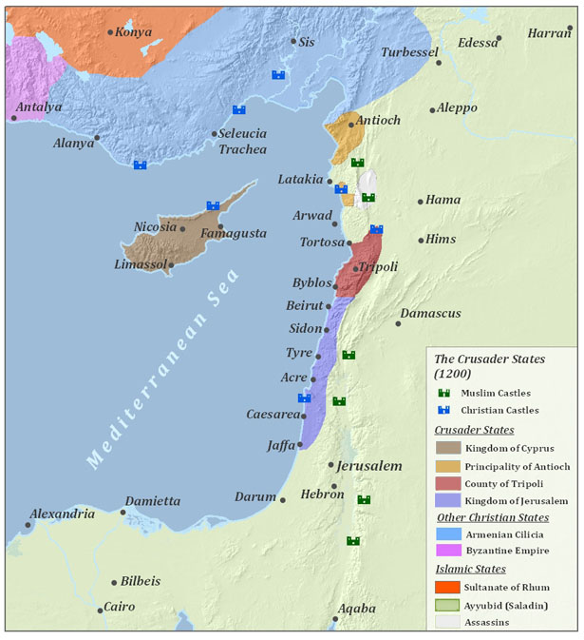
Results
Somewhat successful
Recaptured Acre and Jaffa as holy cites
Did not take back Jerusalem
Remained under Muslim control
3 year truce
Disappointment
Richard the Lionheart
Not going after Jerusalem
Will be jailed in 1192 (killing the Duke of Austria’s Cousin)
Saladin
Failed to drive out the Christians out of Syria and Palestine
Will die of Yellow Fever in 1193
Trade did continue to prosper

Slide 14
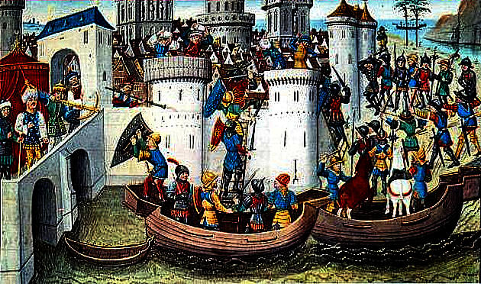
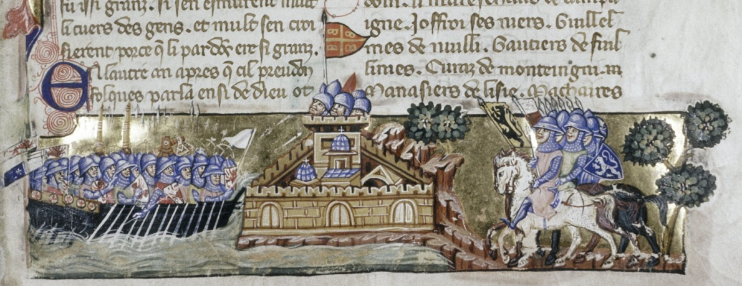
Fourth Crusade (1202-1204)
Attempt to regain Jerusalem, through Egypt
Instead, Crusaders sack Constantinople
Intended to crown an emperor in Constantinople
Were supposed to continue to Jerusalem as the Byzantines offered money and military support
Payments stopped and a sack on Constantinople began

Slide 15
Results
Nail in the coffin for the Great Schism
Religious break between the Eastern Orthodox Church and the Roman Catholic Church
Decline of the Byzantine Empire
Sense of betrayal from the Byzantines and Greek Christians
Constantinople became a Christian puppet state
Last of the Crusades that originate with the Pope

