Slide 1
Unemployment vs Employment

Slide 2
Labor Force
All members of a population who are able to work
Usually ages 18-65
How many people in your group are part of the labor force?

Slide 3
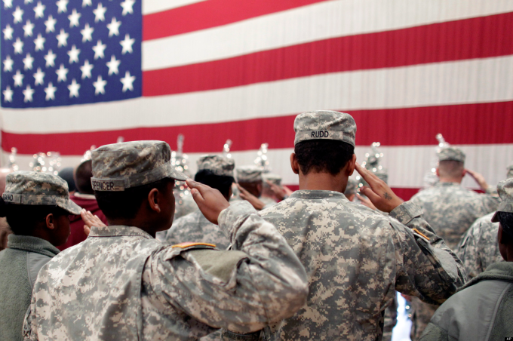
Civilian labor force
The sum of civilian workforce and civilian unemployment
Civilians: population not in the Armed Services who are 16 years or older, and are not in prison, mental institutions, or nursing homes. (Blue group)
http://www.bls.gov/emp/ep_table_303.htm

Slide 4
Labor Force Participation Rate
The participation rate is a measure of the active portion of an economy's labor force.
People who are either employed or actively looking for work (Green group)

Slide 5
Labor Force Participation Rate
Labor Force Participation Rate is used with the unemployment rate because LFPR actually calculates unemployed who might not be actively seeking a job
http://www.investopedia.com/video/play/participation-rate/?ad=dirN&qo=investopediaSiteSearch&qsrc=0&o=40186

Slide 6
What is considered unemployed?
Unemployment rate
percentage of total labor force that is unemployed and actively seeking work and able to work
How much of our population is unemployed? (Pink)
http://www.investopedia.com/video/play/how-unemployment-defined/?ad=dirN&qo=investopediaSiteSearch&qsrc=0&o=40186

Slide 7
Concealed unemployment
Those out of work but are not officially counted
Those who left work and went into early retirement, even though they would still like to work.
Those who have completely given up looking for work
Usually not calculated because they are not necessarily claiming unemployment benefits

Slide 8
Types of unemployment
There are multiple types of employment that afflict our populations
These are the reasons why someone loses a job

Slide 9
1) Frictional Unemployment
Unemployment when someone is in-between jobs
Usually short-lived unemployment
The least problematic
Includes students who just graduated

Slide 10
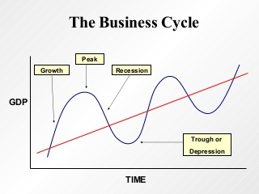
2) Cyclical Unemployment
Unemployment due to the business cycle

Slide 11
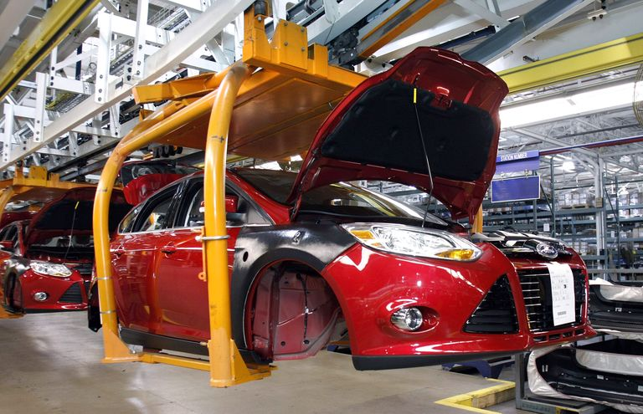
3) Structural Unemployment
Job loss due to things like technology
Can include those who have been laid off/ fired due to recessions
Out of the market for too long, skills become outdated.

Slide 12
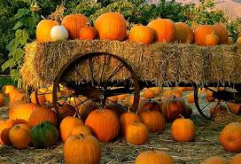
4) Seasonal unemployment
Unemployment due to job supply changes
Seasonal stockers
Farmer’s markets
Home Depot plant waterers
Sometimes school employees

Slide 13
Understanding Unemployment

Slide 14
Real unemployment
Not an actual type of unemployment
Argued to include those unemployed but are searching for full-time jobs
Includes
1) Marginally attached workers
Those who haven’t looked in 4 weeks, but have looked within the year
2) Discouraged workers
Those who have given up on looking for work
3) Part-time workers
Those working part-time but want a full time position

Slide 15
Natural Unemployment
Unemployment that occurs naturally within the market
Usually healthy to have some unemployment

Slide 16
Classical Unemployment
Aka real wage unemployment
Occurs when wages are higher than normal supply and demand
Can happen when….
Unions negotiate higher salaries
Long term contract wages that are too high during a recession
Government sets minimum wage too high

Slide 17
Pair-share
Turn to a partner and discuss:
How does a recession lead to unemployment?
How might unemployment lead to a recession?
Why is 100% employment a negative thing for the economy?

Slide 18
Men at Work??
http://www.npr.org/2016/09/06/492849471/an-economic-mystery-why-are-men-leaving-the-workforce?utm_medium=RSS&utm_campaign=storiesfromnpr
Why are men leaving the workforce?
Why are they not actively seeking jobs?
Do what degree is this a social construct?
Does gender have anything to do with this?
What does this data tell us about the future unemployment rates?

Slide 19
6 Economic Goals
1) Economic Equity
2) Economic Freedom
3) Economic Growth
4) Economic Sustainability
5) Economic Stability/Security
6) Economic Efficiency

Slide 20
Economic Stability
Stability: the lack of extreme fluctuations in an economy
Absence of inflation or deflation
Security: financial security with stable income
What does stability or security look like for employment?

Slide 21
Economic Efficiency
When all resources are used optimally to serve each individual best without waste
Not making one person “better off” while simultaneously making another “worse off”
Command-based economies value economic efficiency higher

Slide 22
Pair-Share
Provide 2 examples where the US values stability over efficiency?
When does the US value efficiency over stability, if ever?

